Slide 2
The Value of Advocacy for SLA members
Advocate With Impact:
SLA Public Policy Advisory Council
Jim Miller
Kendra K. Levine

Slide 3
Agenda
About the Public Policy Advisory Council
Public Policy and Advocacy Survey to Members
Issues of Concern for Information Professionals
An Introduction to Advocacy

Slide 4
About the SLA Public Policy Advisory Council
The mission of the Public Policy Advisory Council is to:
Provide a reference resource informing the SLA community of relevant public policy initiatives that may affect the library and information communities.
Advance informed decisions and statements on public policy issues so that information professionals may advocate on behalf of their communities.
Strengthen SLA advocacy efforts and enhance SLA social media efforts to reach a broader audience.

Slide 5
The Public Policy Advisory Council will:
Establish criteria on public policy issues to follow that impact the field of information/knowledge management and information professionals.
Establish a clear mission and scope specifically focusing on issues impacting SLA and its members vs. the profession at large.
Track and report on public policy issues impacting SLA members and information professionals via SLA communication platforms.
Advise the association’s leadership (including the CEO and senior staff) on importance of issues.

Slide 6
Collaborate with units to ensure information is disseminated, promoted and used.
Develop a clear mission and scope especially regarding internal (members) vs. external communication on public policy issues
Establish goals regarding the type of policy to be tracked and reported
Define a timeframe for releasing statements on policy issues that directly affect SLA members.

Slide 7
Membership Survey
To be launched Fall 2019
We want to hear your views
In collaboration with Diversity, Inclusion, Community, Equality caucus

Slide 8
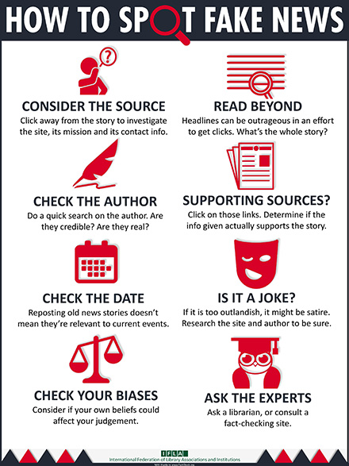
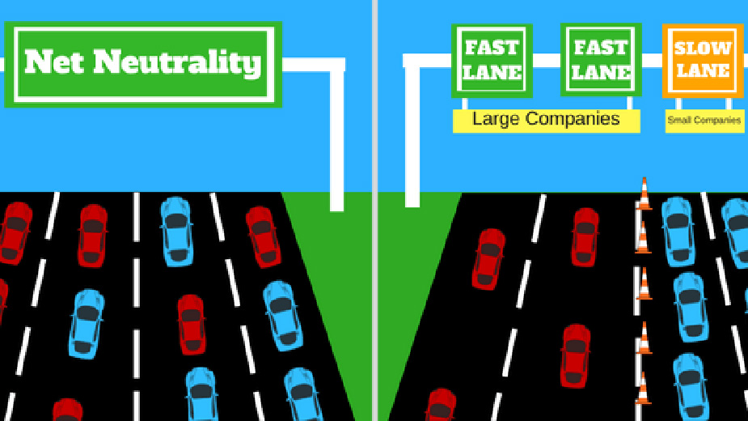
How important are these public policy issues to you?
Fake news
Access to broadband
Net neutrality
Copyright

Slide 9
What other political issues do you believe will impact our field in 2-5 years?

Slide 10
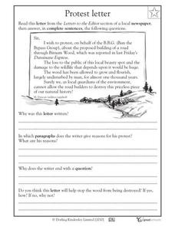
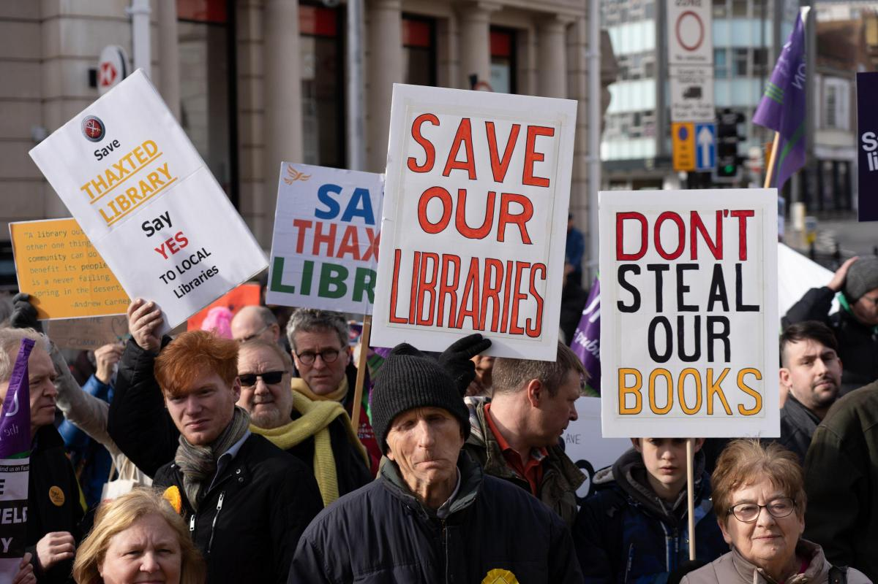
How likely are you to promote/campaign for/defend public policy issues that impact your profession/position?

Slide 11
Net Neutrality
Network neutrality is the principle that internet service providers should treat all data equally and should not discriminate or provide preference to any data regardless of its source, content, or destination.
Net neutrality is essential for libraries to meet our public mission and is an expression of our professional values. America’s libraries collect, create, and disseminate essential information to the public over the internet.

Slide 12
Broadband
Nearly 33 million U.S. households do not use the internet at home, and nearly twice that number of people in the U.S. have low levels of digital readiness.
Digital opportunity gaps disproportionately impact low-income families, rural and tribal communities, Blacks, Latinos, and people with disabilities. The leading reasons for these gaps are lack of access and affordability, which leads to a lack of digital literacy.
Affordable, high-capacity broadband internet access is critical to the mission and operation of every modern library. Broadband in library facilities is used by patrons to access digital collections, e-government services, and legal information, distance learning, telemedicine, and many other essential community services.

Slide 13
Copyright
It is impossible to honor professional cores values of librarians—first amendment, equity of access, and inclusion—without copyright law. Without it, libraries would be unable to loan books, preserve content, and exercise fair use.
Libraries have a privileged position in the law with individual exceptions that apply only to non-profit libraries and archives.
Congress recognized that libraries are sites of learning, where protected content will be continually available, distributed, used, and preserved to further knowledge, fostering the Constitutional purpose of the law “to advance the progress of science and the useful arts” to benefit the public.

Slide 14
Fake News
Libraries have an institutional and ethical commitment to help users access reliable and authentic information. This role is as important as ever in an era when “fake news” is a seemingly growing phenomenon.
At the individual level, active library efforts to build relevant media and information literacy can also help support citizens to evaluate critically the credibility and appropriateness of information sources.

Slide 15
What is Advocacy?
Advocacy is a political process by an individual or a large group which normally aims to influence public-policy and resource allocation decisions within political, economic, and social systems and institutions; it may be motivated from moral, ethical or faith principles or simply to protect an asset of interest.
Policy generally refers to 'social' policy. Policy advocacy usually seeks to engage various sectors of the government which includes: public servants, bureaucrats, political appointees, elected officials and legislators.
Notes:
In a 2016 article, Library Journal reached out to academic and public library directors and other thought leaders nationwide to find out what new skills they expect to need in librarians in the next 20 years.
Advocacy was listed as one of the top skills that librarians should have.
According to the article, this key competency has two distinct but overlapping paths: raising awareness of value among stakeholders, with an eye to maintaining or increasing funding, and building community, organization, and outreach, with an eye to expanding those services and effectively serving the constituencies who need them.

Slide 16
An advocate is defined as someone who publicly supports, champions, or recommends a particular cause, organization, or policy.
Do you advocate for causes or issues you are passionate about?

Slide 17
The Need for Advocacy
Increase awareness of the value you add
Increase government funding for your initiatives/projects
Demonstrate your expertise in informing policy decisions
Introduction of new methods or processes
Notes:
For many organizations the information centre and the information professionals that work within them are seen as a cost centre. There is no money to be made in the services they provide to other employees within the organization is the usual thinking.
We as information professionals know otherwise that this is simply not the case. There is significant value in the services we provide. In fact, the information, intelligence and services provided by information centres contributes greatly to decision-making processes throughout the organization.
So why is it that the information centre is usually the first area targeted when cuts need to be made?

Slide 18
Successful Strategies
Partnerships – show leverage
Show connection to government priorities
Should be win-win
Show opportunity cost of not doing it

Slide 19
Successful Strategies
Have a Plan
Need a focussed ask
Do your research
Know the right person to talk to

Slide 20
Some Ideas of What You Can Do
Educate yourself - visiting web sites, attending events, reading articles, etc.
Attend an event
Write a blog or editorial
Volunteer
Post or share updates on social media
Donate money
Sign a petition addressed to a government or business leader
Visibly promote via clothing or stickers, etc.

Slide 21
Getting your message in front of politicians
Think local – Get your politicians working for you
Connect your message with government message in newsletters
– send a copy to politician.
Events – Opportunity for both you and elected official to
get media coverage

Slide 22
Environmental scanning/monitoring
Environmental monitoring allows organizations to use information strategically to adapt to external change and to foster internal growth. This model examines how people and groups within organizations use information to create an identity and a shared context for action and reflection; to develop new knowledge and new capabilities
Awareness can easily be achieved by environmental monitoring and regularly meeting with government officials to understand “what they are working on”. Advocacy is as much a listening and learning exercise as it is a speaking and teaching exercise

Slide 23
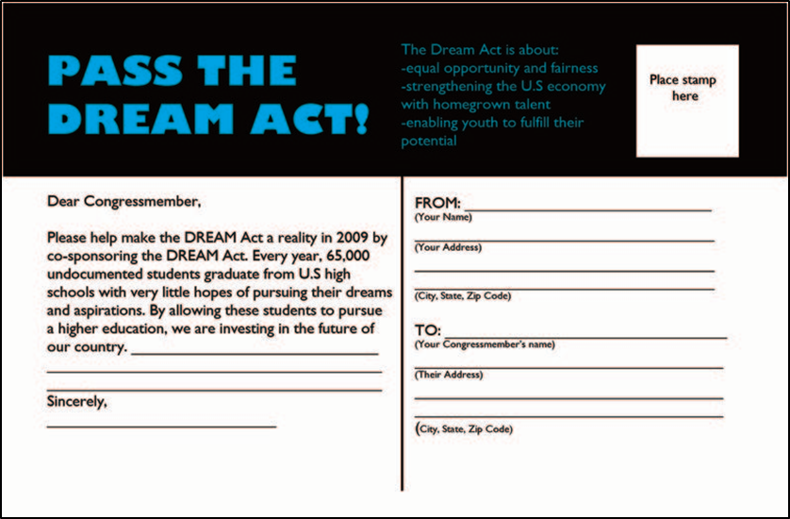
Minimum Effort gets Minimum Response

Slide 24
SLA Public Policy Advisory Council

Slide 25
Look for the SLA PPAC Connect Community…coming soon!

